Slide 1



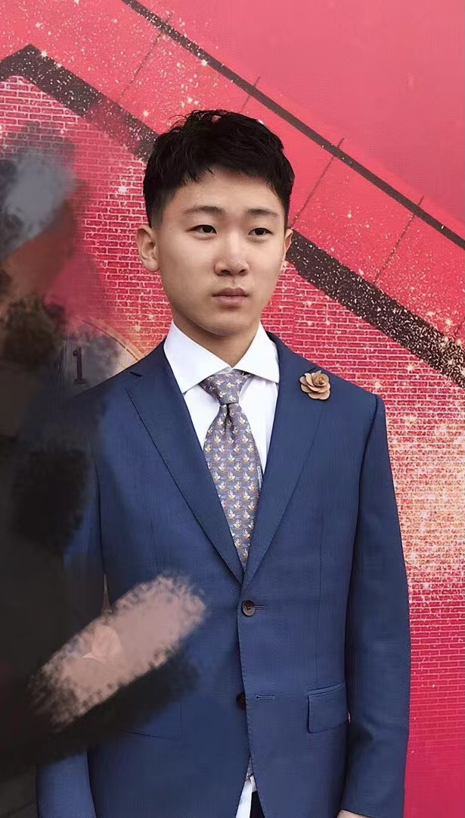

Aijia Ma
Austin Trout
Cong Xu
Garfield Zhang

Slide 2
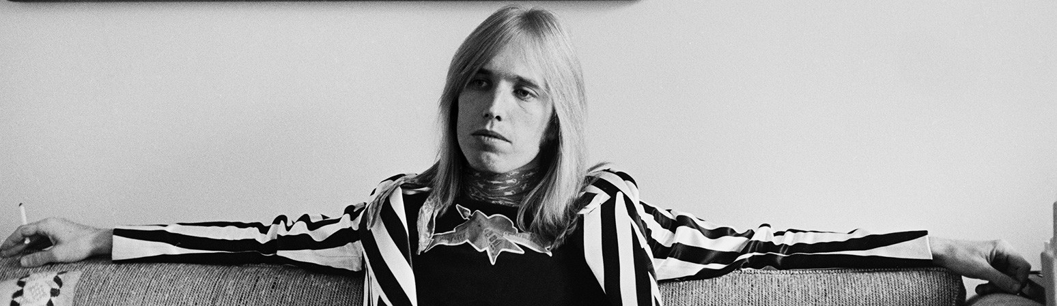
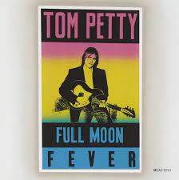


(1989)
(1994)
(2006)

Slide 3
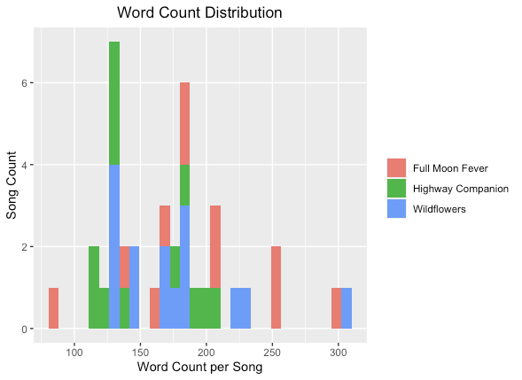
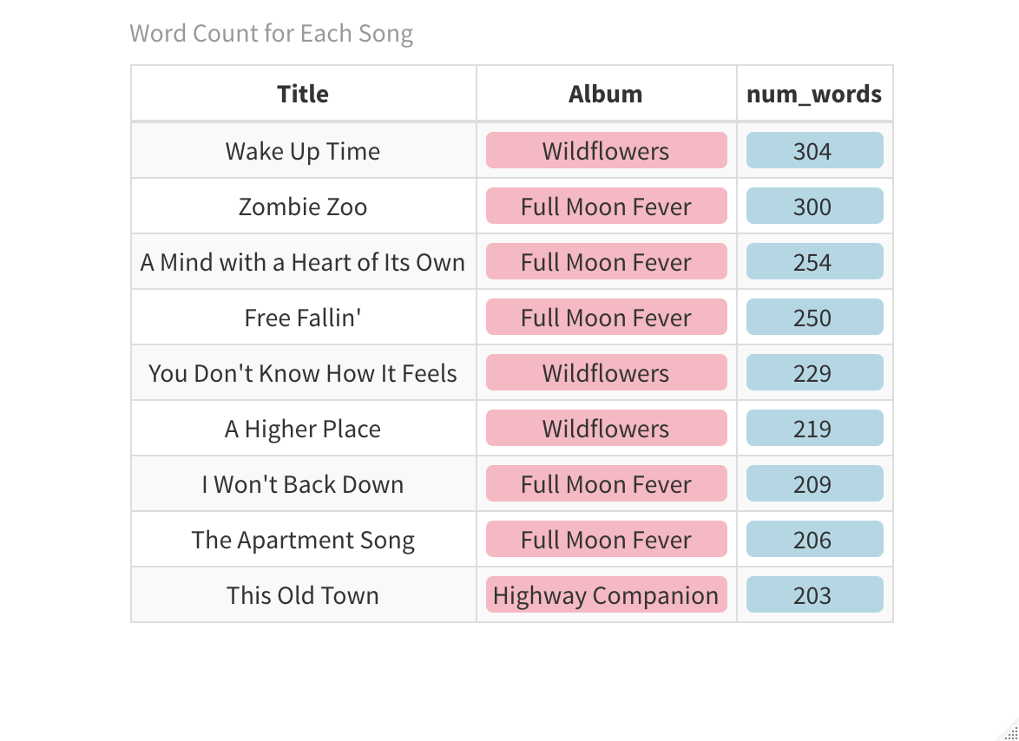
Quantity of Words
"Alright For Now"

Slide 4
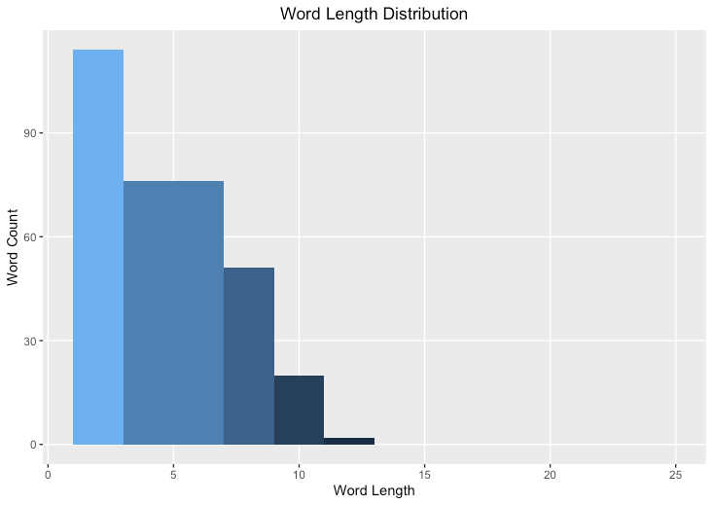
Word Length
Simplistic
Commonly-used language
Conscientious is longest word

Slide 5
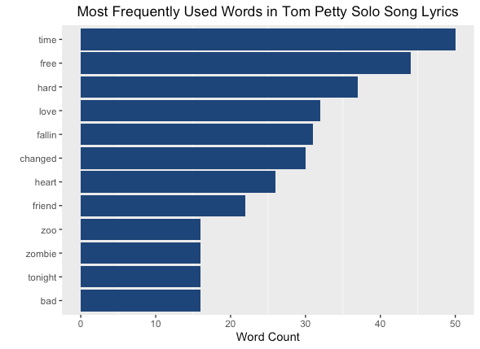
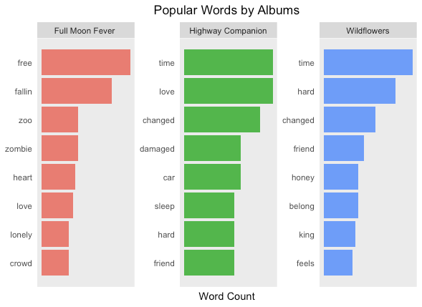
Most Popular Words
Repetitive, chorus-heavy
Themes of time, changes, and relationships

Slide 6
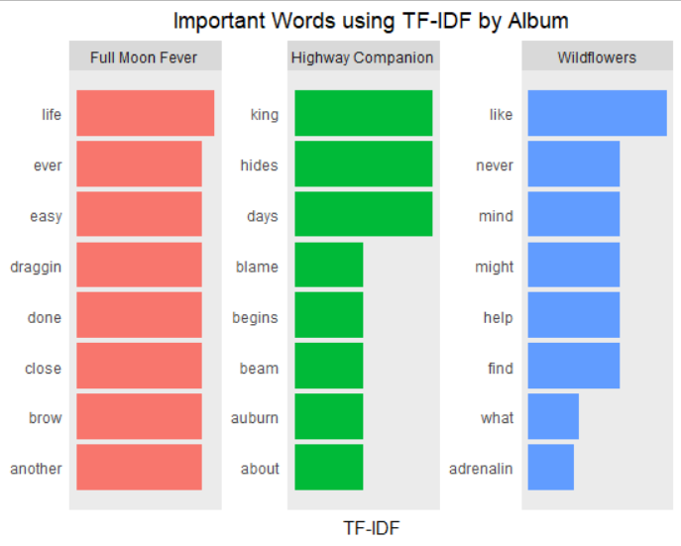
TF-IDF
“Average” life topics/challenges
More reflective in Wildflowers

Slide 7
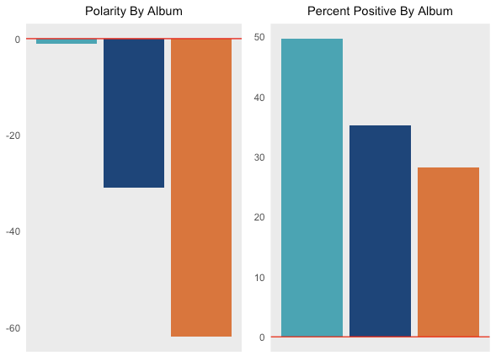
Sentiment
Sounds pleasant, negative sentiment
Melancholic?
More negative later in life

Slide 8
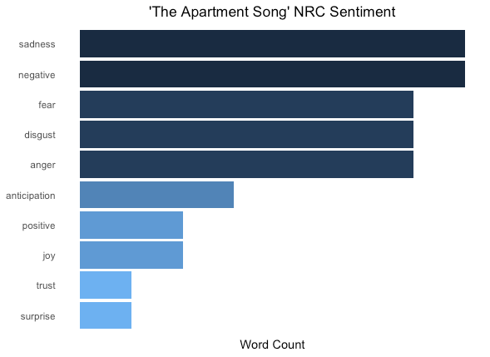
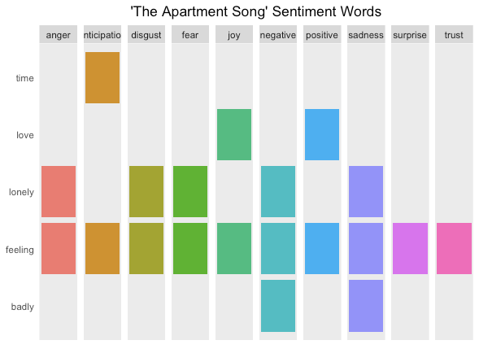
Notable Tracks
A fast-paced song, but is negative with little word variability

Slide 9
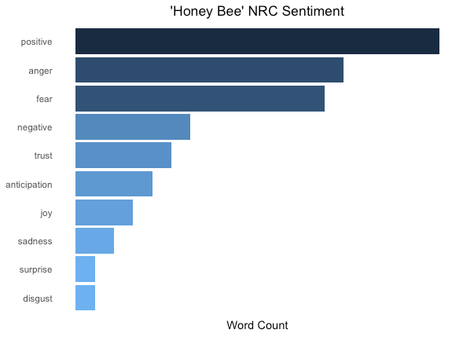
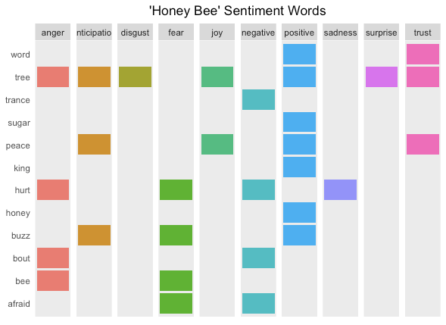
Notable Tracks
Bee is categorized under anger and fear

Slide 10
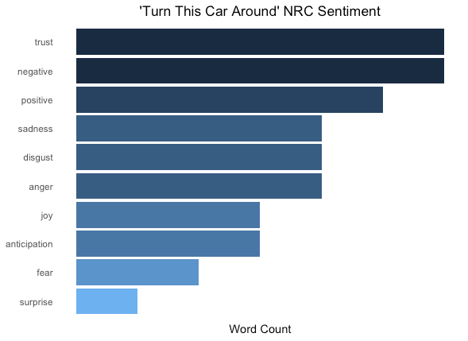
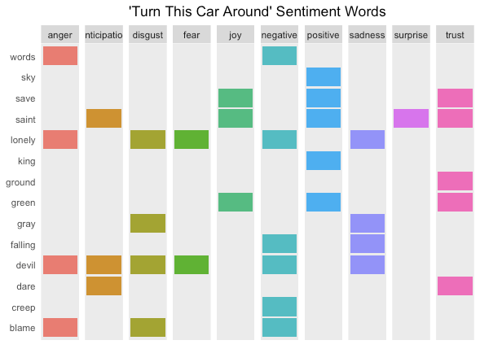
Notable Tracks
Trust but negative at the same time?

Slide 11
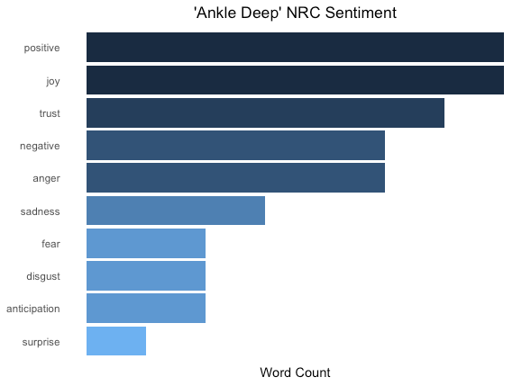
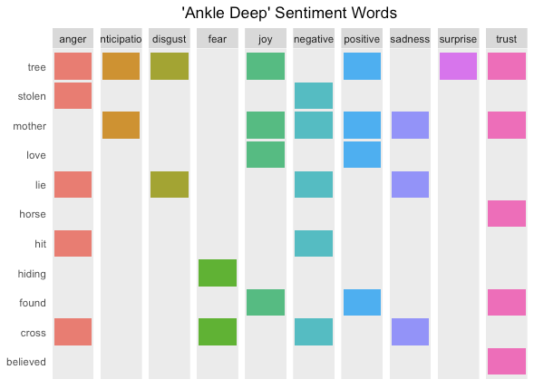
Notable Tracks
Horse is categorized under trust (compare it with bee) and mother involves sadness

